Slide 1
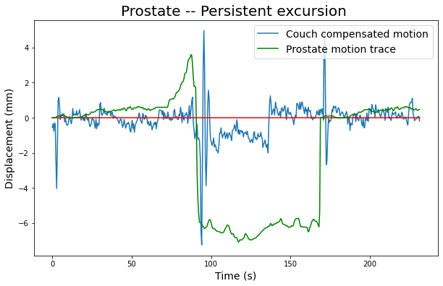
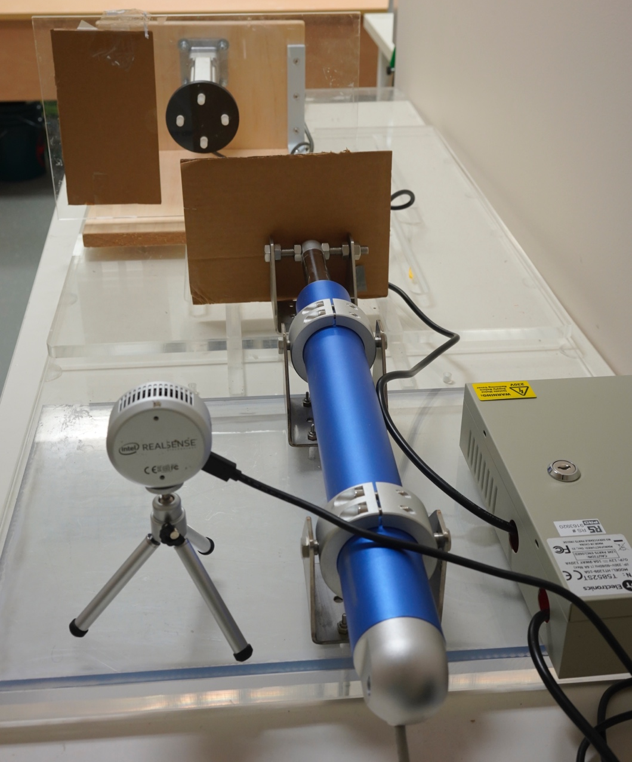
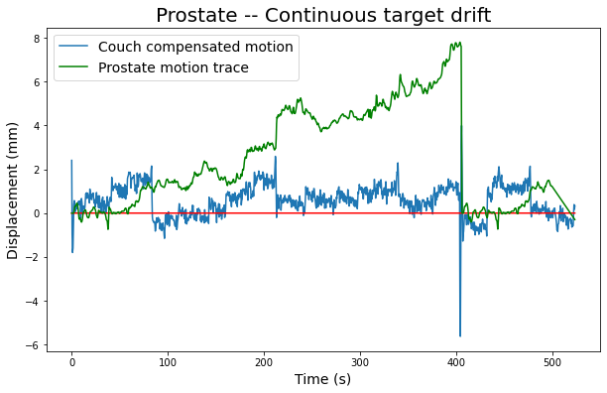
1D platform
Couch & Couch motor
RealSense depth camera
a)
b)

Slide 2

Couch Tracking Flowchart –with Intel Realsense depth camera UDPsender_realtime.py
Platform moves in 1D, based on the input trace.
Depth camera measures depth values in real-time. Write to csv file, frame number, timestamp, ROI1 depth values (1D platform), ROI2 depth values (couch)
Couch is receiving ROI1 depth values via UDP in real-time. Motor travel in opposite direction of 1D platform to achieve motion compensation.
*** For code details please see couch tracking pseudocode document.
Input Trace
1D platform
Depth camera
Couch
Frame No. Timestamp, ROI1, ROI2
Couch Motor

Slide 3
Couch Tracking with pre-recorded trace Flowchart – UDPsend_trace.py
UDP sender
Input Trace
Depth camera
Couch
Depth camera
Frame No. Timestamp, ROI1, ROI2
1D platform
Frame No. Timestamp, ROI1, ROI2
Couch Motor

Slide 4
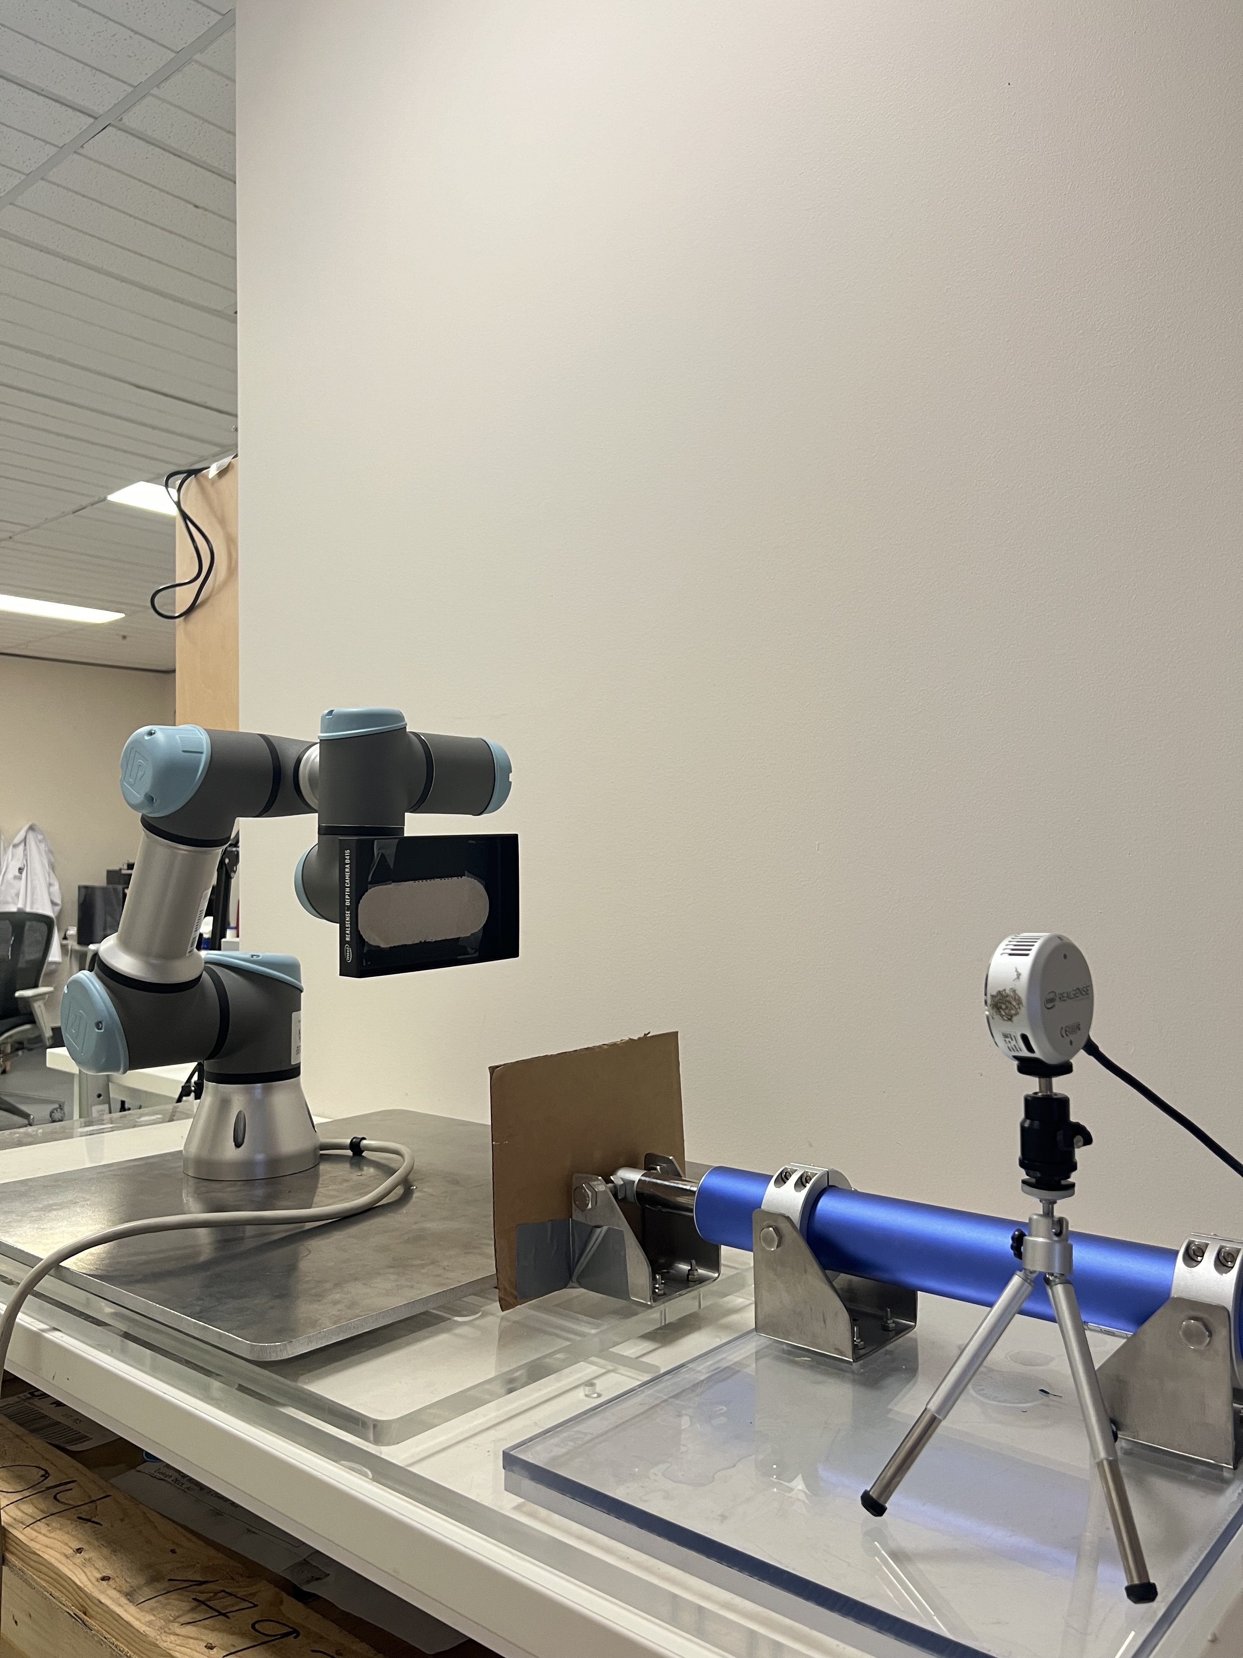
Robotic arm to replicate target motion
Intel Realsense depth camera
Linear actuator motor
Couch

Slide 5
Isocenter
Target motion range
Compensated motion range
Tracking Target
(6Dof Robotic arm/
1D motion platform)
Tracking Tool
(KIM/
Depth measurement)
Target being tracked,
Positional measurement generated
Measurements are sent to couch via UDP
Movable Couch

Slide 6
Intel RealSense depth camera
(Surface tracking)
KIM
(Internal motion tracking)
Other methodologies…
Couch Compensation

Slide 7
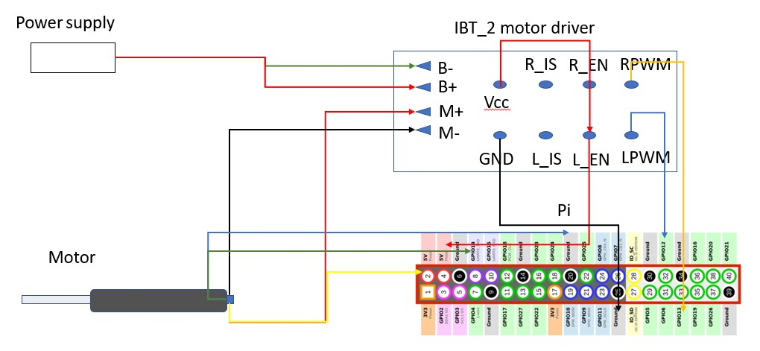
Raspberry Pi connection

Slide 8
Couch Hardware
Couch Motor
https://www.firgelliauto.com.au/products/bullet-series-50-cal-linear-actuators
Tested highest speed 12mm/s with no load. Higher load decreases the motor speed.
System control
Raspberry Pi enables motor operation and executes motion compensation.
Raspberry Pi Model 4B 8GB RAM with at least 16GB SD card.
https://www.raspberrypi.com/products/raspberry-pi-4-model-b/

